Slide 1
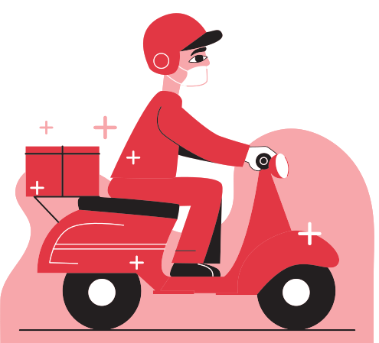
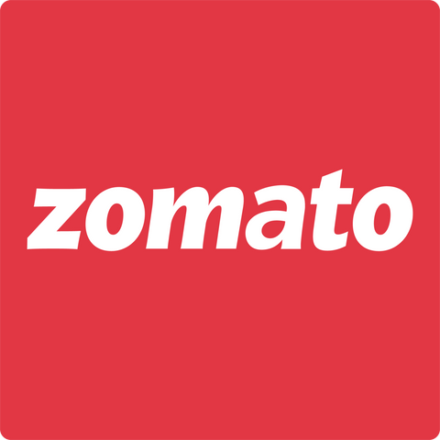
Enhancing Zomato's Digital Experience
An Analytical and AI-driven Approach
Pratiksha Thorat
+91-9307322092
pratikshafiske@gmail.com
24X7
4.5*
3M+
9M
Delivery
Rating
Restaurants
Reviews

Slide 2

Story About zomato
Zomato (/zoʊmɑːtoʊ/) is an Indian multinational company that aggregates restaurants and provides food delivery services. Founded by Deepinder Goyal and Pankaj Chaddah in 2008, Zomato offers restaurant information, menus, user reviews, and food delivery from partner restaurants in over 1,000 Indian cities and towns as of 2022–23. In 2024, Zomato remains a leading food delivery and restaurant aggregator, headquartered in Gurugram, India, and operating in key markets like India, UAE, and Australia. Their comprehensive services include food delivery, restaurant discovery, online ordering, table reservations, and Zomato Pro membership for exclusive benefits. They also provide grocery delivery and gourmet food options through Zomato Market. Leveraging AI, they deliver personalized recommendations, optimize delivery routes, and enhance customer support with AI chatbots. Advanced analytics drive their strategic decisions, solidifying their market position against competitors like Swiggy and Uber Eats.
Vision
Mission
Zomato help users find good places to eat anywhere in the world.
Zomato's ensure that nobody has a bad meal by helping users discover great places to eat and enabling restaurants to provide better experiences.

Slide 3


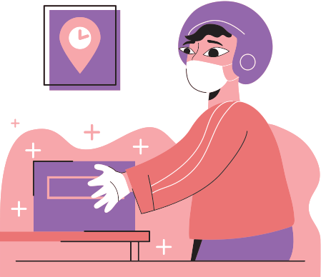


What zomato Do
At Zomato, they offer a digital platform for food delivery, restaurant discovery, online ordering, and table reservations. Their Zomato Pro membership provides exclusive discounts and benefits. They also deliver groceries and specialty food items through Zomato Market. Leveraging AI, they personalize recommendations, optimize delivery routes, and enhance customer support with chatbots. Additionally, they provide a live feature offering a curated selection of premium events, including festivals, concerts, and tours. Moreover, through their subsidiary company Blinkit, accessible via the Zomato app, they offer grocery delivery services, expanding their convenience and service offerings to customers. Advanced analytics drive their strategic decisions, ensuring an exceptional user experience and maintaining their leadership in the market.
Food Delivery
zomato LIVE
B2C: Providing food straight to customers homes with just a few clicks
It offers a curated selection of premium events, including festivals, concerts, and tours.
Dining
Grocery Delivery
A table booking service that allows its users to make, modify and cancel bookings, at a restaurant they wish to dine in
It has a link to blinkit(Subsider company) to explore & buy groceries.

Slide 4




What zomato Offer
The main work of Zomato is to suggest local and nearby restaurants to users and receive orders from them. Users can place orders from their favorite restaurant based on ratings and reviews shared by previous customers.
Fast Delivery
Best Price
Online Payment
Fast Respond
Zomato guarantees the quickest delivery service.
Zomato gives you a flat 50% discount on your first order by using zomato coupons for new users
Facilitate seamless online payment options to minimize physical contact.
Zomato ensures rapid resolution of customer queries.

Slide 5


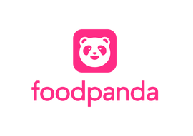


Market Analysis
Competitors:
Swiggy, Uber Eats (in certain regions),
Foodpanda, Dunzo
Comparative Analysis:
Feature
Coverage | 1000+ cities in India, UAE, Australia | 500+ cities in India | Limited regions globally | Asia and Middle East | Select Indian cities
Restaurant Listings | Extensive with diverse cuisines | Extensive with local focus | Limited but growing | Moderate | Moderate
Pricing | Competitive | Competitive | Generally higher | Competitive | Varies
User Satisfaction | High (4.5/5) | High (4.4/5) | Moderate (4.1/5) | Moderate (4.0/5) | Moderate (4.0/5)
Unique Features | Zomato Pro, Live Events, Blinkit (grocery delivery) | Swiggy Genie (anything delivery), Swiggy Pop | Uber Pass, Ride Integration | Exclusive deals, Pandamart (groceries) | Quick deliveries, diverse services
Conclusion:
Strengths:
Broad coverage and extensive restaurant listings.
Competitive pricing and high user satisfaction.
Unique features like Zomato Pro and live events integration.
Grocery delivery through Blinkit.
Areas for Improvement:
Enhancing local presence and customization to compete with Swiggy’s local focus.
Expanding into new regions to challenge Uber Eats’ global reach.

Slide 6


Identification of Improvement Areas:
Dineout Recommendation
Inaccurate Proximity Recommendations in Zomato's Dineout Feature
Integration Issue
with Blinkit in the Zomato App
Season wise recommendation
Seasonal Relevance in Recommendations
Event Sorting in Zomato Live
timely decisions regarding upcoming events.

Slide 7
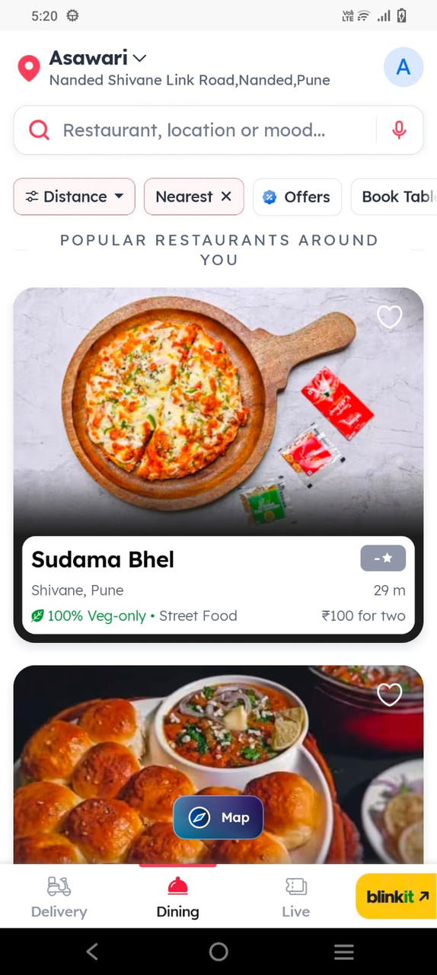
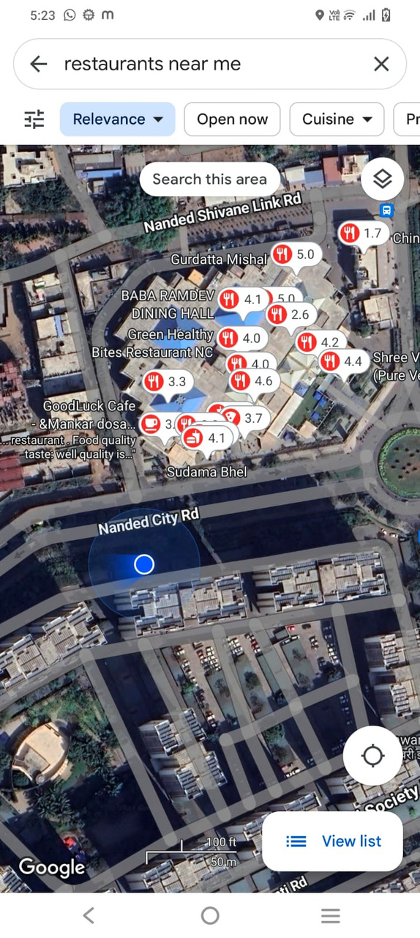

zomato sort by nearest
Actual location on Gmap
& nearby restaurants
Inaccurate Proximity Recommendations in Zomato's Dineout Feature
In the Zomato app, the Dineout feature often displays restaurants that are far away, even when many well-known and popular options are located nearby. I have images that illustrate this discrepancy.

Slide 8
AI Solution for Improved Restaurant Recommendations
To address the issue of showing far-away restaurants instead of nearby popular ones, Zomato can implement the following AI-based solution:
1. Enhanced Location-Based Filtering:
Geolocation Accuracy: Use advanced geolocation algorithms to accurately detect the user's current location.
Proximity Algorithm: Develop an AI-powered proximity algorithm to prioritize restaurants based on their distance from the user.
2. User Preference Learning:
Personalized Recommendations: Implement machine learning models to analyze users' dining history and preferences, offering personalized restaurant recommendations.
Real-time Feedback: Allow users to provide real-time feedback on restaurant suggestions, using this data to continuously refine the recommendation engine.
3. Popularity and Review Integration:
Popularity Metrics: Incorporate metrics such as user ratings, number of reviews, and overall popularity into the recommendation algorithm.
Dynamic Updates: Ensure the system dynamically updates the restaurant listings based on changes in ratings and reviews.
4. Context-Aware Suggestions:
Time and Occasion-Based Filtering: Use AI to provide suggestions based on the time of day, day of the week, and special occasions, ensuring the recommendations are contextually relevant.
Event Integration: Integrate the live feature with restaurant recommendations, suggesting dining options near events the user is interested in.
5. User Interface Enhancement:
Interactive Map View: Offer an interactive map view that highlights nearby restaurants, allowing users to see at a glance which options are closest.
Customizable Filters: Allow users to set their own distance preferences and filter options to tailor the recommendations to their needs.
By implementing these AI-driven enhancements, Zomato can significantly improve the accuracy and relevance of its restaurant recommendations, ensuring users have a more satisfying and personalized dining experience.

Slide 9
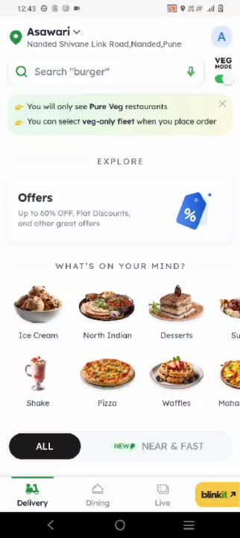
Integration Issue with Blinkit in the Zomato App
When using the Zomato app, the Blinkit option redirects users to a separate app for grocery delivery. This creates a barrier, as not all customers are willing to download an additional app. To retain grocery customers, Zomato should consider integrating Blinkit services within the main Zomato app, providing a seamless experience for users.

Slide 10
Integrate Blinkit Services within the Zomato App
1. In-App Integration:
Unified Interface: Merge Blinkit’s grocery delivery services into the existing Zomato app, allowing users to access all features without switching apps.
Single Sign-On: Implement a single sign-on system so users can access Blinkit services with their Zomato credentials.
2. Enhanced User Experience:
Seamless Navigation: Create a dedicated section for grocery delivery within the Zomato app, ensuring easy navigation and access to Blinkit’s offerings.
Consistent Design: Maintain a consistent user interface and experience across both food delivery and grocery sections.
3. Cross-Promotional Opportunities:
Unified Promotions: Offer combined deals and discounts for food and grocery orders, incentivizing users to utilize both services.
Integrated Recommendations: Leverage AI to provide personalized recommendations for groceries based on users’ food order history.
4. Streamlined Operations:
Centralized Customer Support: Provide a single customer support system for both food and grocery delivery, simplifying user assistance.
Combined Order Management: Allow users to place and track food and grocery orders simultaneously, enhancing convenience.
5. Marketing and Communication:
Unified Branding: Promote Blinkit services through Zomato’s marketing channels, emphasizing the convenience of a single app for all needs.
User Education: Use in-app notifications and tutorials to educate users about the integrated grocery delivery feature.
By integrating Blinkit’s services directly into the Zomato app, the company can provide a more cohesive and convenient experience for users, thereby retaining grocery customers and enhancing overall satisfaction.

Slide 11
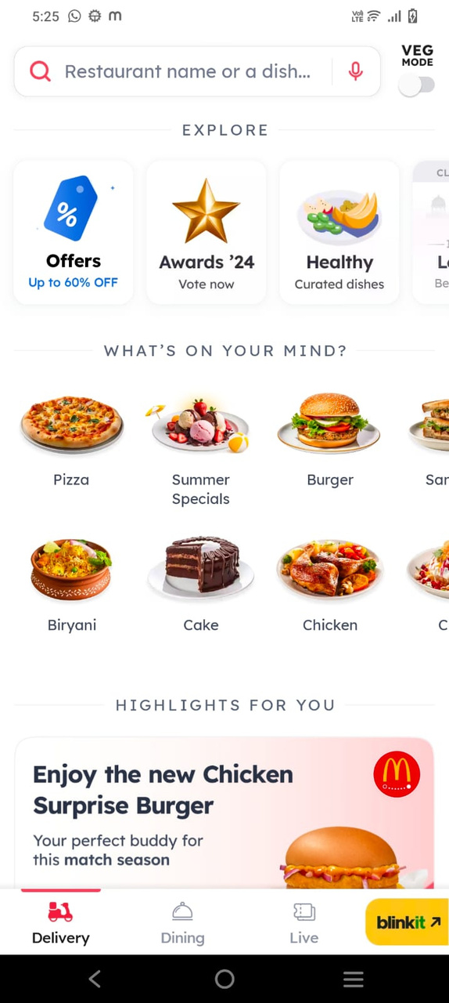
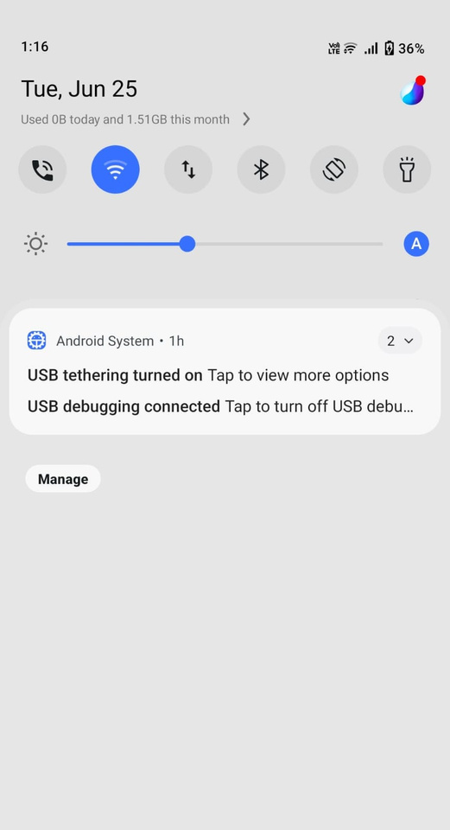
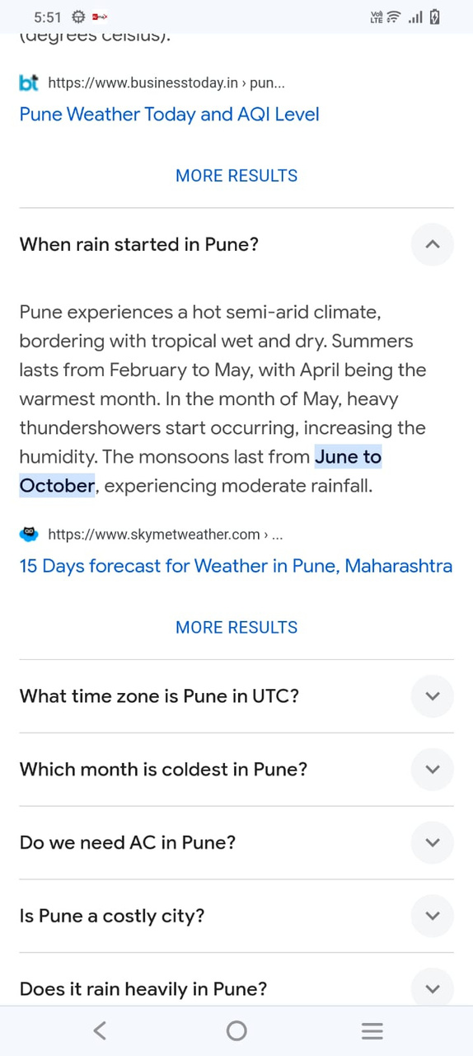

Seasonal Relevance in Recommendations
As of June 25th, in Pune, the monsoon season runs from June to October. Currently, Zomato is displaying summer special dishes like ice cream at the top of the recommendations. To stay updated and attract customers, Zomato should improve its seasonal relevance by showcasing popular monsoon dishes such as pakode and vadapav during the rainy season.

Slide 12

Enhancing Seasonal Relevance in Zomato Recommendations
To improve seasonal relevance in Zomato recommendations based on customer location and seasons throughout the year, the following AI-driven solution can be implemented:
1. Seasonal Pattern Recognition:
AI Algorithms: Develop machine learning models to recognize seasonal patterns based on historical data and local weather conditions.
Location-based Analysis: Use geolocation data to determine the customer's location and local seasonal variations.
2. Dynamic Content Adaptation:
Real-time Updates: Integrate weather APIs to provide real-time updates on local weather conditions, adjusting recommendations accordingly.
Contextual Awareness: Implement AI algorithms that dynamically adapt recommendations based on current seasonality trends in the customer's location.
3. Customer Preference Modeling:
Behavioral Analysis: Analyze user behavior and ordering patterns to understand seasonal food preferences.
Personalized Recommendations: Utilize AI to personalize recommendations by suggesting seasonal dishes that align with individual customer preferences.
4. Regional Customization:
Localized Content: Customize recommendations based on regional culinary traditions and seasonal specialties.
Cultural Relevance: Incorporate local festivals and cultural events into recommendation algorithms to highlight relevant seasonal dishes.
5. User Engagement Strategies:
Promotional Campaigns: Launch targeted marketing campaigns featuring seasonal dishes to increase awareness and engagement.
Interactive Features: Enhance user interaction with in-app features that allow customers to explore seasonal menus and provide feedback.
By implementing these AI-driven enhancements, Zomato can optimize its recommendations to reflect seasonal variations and local preferences effectively. This approach not only enhances user satisfaction but also boosts engagement by offering timely and relevant dining options throughout the year.

Slide 13
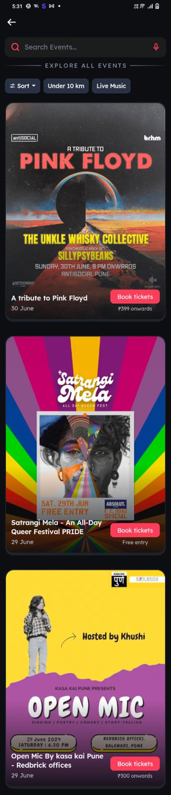

Event Sorting in Zomato Live
Currently, in Zomato Live, events scheduled for 30th June are prioritized over those for 29th June, despite today being 25th June. This arrangement may cause confusion and hinder customers' ability to make timely decisions regarding upcoming events.

Slide 14
AI-Based Event Sorting Enhancement
To improve user experience and decision-making in Zomato Live, the following AI-driven solution can be implemented:
1. Real-Time Sorting Algorithm:
Dynamic Event Sorting: Develop an AI algorithm that sorts events based on their proximity to the current date, prioritizing earlier dates first.
Date Comparison: Use date comparison logic to ensure events closer to the current date are displayed prominently.
2. User Context Awareness:
Geolocation Data: Utilize geolocation to customize event sorting based on the user's location, ensuring relevance to local time zones and preferences.
Personalized Preferences: Incorporate user history and preferences to prioritize events aligned with past attendance or interest.
3. Enhanced Filtering Options:
User Controls: Provide filtering options for users to sort events by date, location, and categories such as music, food, or sports.
Customizable Views: Enable users to customize their event feed based on personal preferences, ensuring a tailored experience.
4. Real-Time Updates and Notifications:
Push Notifications: Send real-time notifications to users about upcoming events based on their preferences and location.
In-App Alerts: Implement in-app alerts for newly added or rescheduled events, keeping users informed and engaged.
5. Continuous Improvement and Feedback Loop:
Feedback Mechanism: Integrate a feedback system to gather user input on event sorting preferences and usability.
Iterative Updates: Use feedback and analytics to continuously refine the sorting algorithm and enhance user satisfaction.
By implementing these AI-driven enhancements, Zomato can optimize event sorting in Zomato Live, ensuring users have a seamless experience accessing and prioritizing upcoming events based on their relevance and proximity to the current date.

Slide 15

Best Regards
Pratiksha Thorat
pratikshafiske@gmail.com
+91-9307322092

